Slide 1
Function or Not a Function?

Slide 2
Let’s think…

Slide 3
Vertical Line Test
Vertical line
To pass the vertical line test, it can touch the vertical line only once.

Slide 4
Are these functions? Why or why not?
{(1,5) (2,5) (3,6)} {(4,1)(5,7)(5,10)(6,8)}
4
5
6
1
7
8
10

Slide 5
Are these functions? Why or why not?
1
2
3
4
3
4
5

Slide 6
Are these functions? Why or why not?
{(2,3),(5,6),(4,8),(2,4)} {(-3,1)(5,2)(7,8)(2,3)}
X | Y
2 | 3
5 | 6
4 | 8
2 | 4
X | Y
-3 | 1
5 | 2
7 | 8
2 | 3

Slide 7
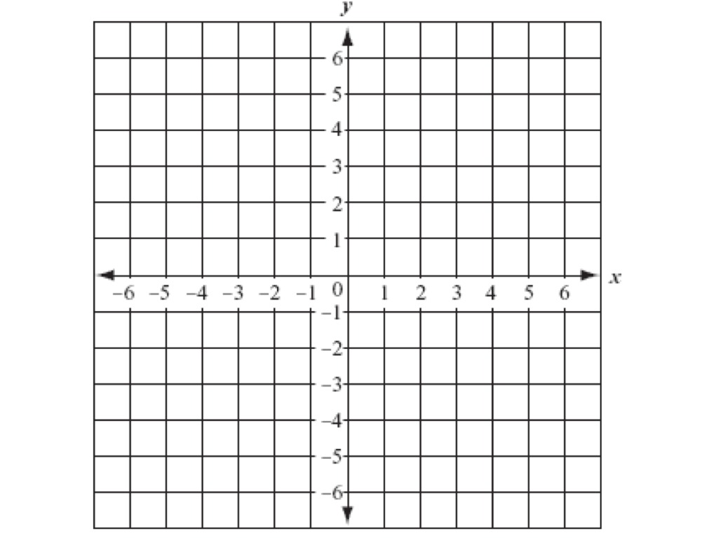
Which of these graphs is a function?

