Slide 1
Pre Calculus
Ms. Hernandez
Room 2010
mherna21@aisd.net

Slide 2
About Me
Education:
Skyline High School (Dallas)
Mountain View College (Associates in Science)
University of North Texas (Bachelor ‘s degree in Mathematics)

Slide 3
PreCal
Welcome!
There are three main goals for this class:
Prepare you for Calculus
Explore Algebra and Trigonometry topics in more depth and detail
Learn problem-solving techniques

Slide 4
Grades
Your grade in this class will be based on the following:
50% Major Test
25% Quizzes
10% Classwork/ Group Work
10% Homework
5% Project

Slide 5
Homework
Homework must be completed at the beginning of class to receive full credit. 20 points will be deducted for each day late (Not class period).
The “tri-fold” form will be used to complete all homework problems.
Work must be legible and neat or it will not be accepted.
NO WORK = NO CREDIT

Slide 6
Absences and Make-Up Work
If you are not present in class, (sickness, doctor’s appointment, school function), you will be counted as absent.
If you are absent, you are responsible for all make-up work. You are allowed the same number of days to make-up work for which you were absent. If your absence is unexcused, you will receive zero(s) for that day’s assigned work.
To find out what you missed, check your assignment calendar in the back of the classroom.
If you were absent the day of a test/quiz, you will be expected to take the test/quiz the day you return to class- so be prepared.
For school related absences, you need to work ahead and be prepared for class when you return. In other words, copy the notes from the website, complete the homework, and take quizzes/test in advance.

Slide 7
Tutoring
Monday & Wednesday: 2:45-4:00 pm
Wednesdays – (During Gold Lunch)
Any other time, (mornings, or any other day of the week not mention), by appointment only.**

Slide 8
Supplies
Please bring to class:
5 subject Spiral**
Pencil and Eraser
Highlighters
Notebook paper**
Graph paper
Failure to bring the required supplies can lower your class participation grade.

Slide 9
Textbook
Ron Larson, Precalculus with Limits: A Graphing Approach, Texas Edition, 6th edition (Textbook will be issued on digital format only).

Slide 10
Cheating
Any Student involved in any manner of cheating on any given assignment will get a zero that will NOT be dropped.

Slide 11
Expectations
I expect each of you to
Be in your seat when the bell rings.
Have your supplies with you each day.
Treat your fellow classmates and me as you would wish to be treated.
Act like you have a positive attitude (even if you don’t).
Put forth your best effort.
Ask for help if you need it, and be willing to help others when asked.

Slide 12
Goals
My goal is for this class to be a challenging, interesting course that will prepare you for whatever you choose to do in your education after high school.
My goal is to treat everyone with respect. If you ever feel I have failed in this, please come see me.
My goal is for everyone in this class to be successful. How well you succeed will depend on the the amount of effort you are willing to put forth, but I will help you in any way that I can.

Slide 13
Class Rules
Treat each person and his or her property with respect.
Do what I ask you to do when I ask you to do it.
Do not talk when I am talking.
No personal grooming. (I will confiscate.)
No throwing.
No food or drink in class.
Follow all school rules and policies.
Failure to follow the class rules will earn you a referral and possibly your exemptions.

Slide 14
Bathroom
If you need to use the bathroom during the times posted next to the shelf, you do not need to ask permission. You may just grab my hall pass and go.
If someone is already using my pass, you will need to wait until that person returns. If more than one person needs to go, work it out among yourselves.

Slide 15
Website
mshernandez9.weebly.com
Here you can find notes and assignments. I will later add a class’s calendar.

Slide 16
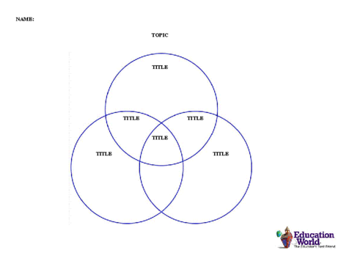
Get-to-Know-You Venn Diagram

